Slide 1
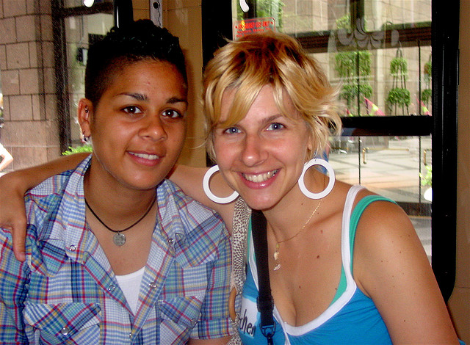

Positive Relationships
[Professor Name]
[Class Section Number]
Notes:
Class Recommendations: This module can be taught in one 90-minute class, or two-shortened class periods (45 to 60 minutes).
Overview: This module describes some research about positive relationships. With so many marriages that end in divorce and high levels of infidelity in relationships, how can we create and maintain positive relationships? This module highlights some research that may help individuals.
Technical Note: These slides may contain simple click animation so that you can focus students’ attention on a particular question, a selection of text, or an image and not have them be distracted by reading ahead. You can either preview the sequence of animation by going through the slides in slideshow view, visiting the animations tab, or reviewing the slide notes. In the notes you will see a cue - (Click) – that corresponds to each animation.
You will also find hyperlinks to outside videos at various places in the slides. These hyperlinks are embedded in text and indicated by color and in the notes section.

Slide 2
Today’s Learning Objectives
Understand some of the challenges that plague close relationships today.
Become familiar with the concept of positive emotional deposits.
Review some of the research that is relevant to positive emotional deposits.
Describe several ways people make positive emotional deposits.
Notes:
This slide outlines the learning objectives of the module.

Slide 3
Overview
Introduction
Positive Relationship Deposits
The Magic Formula
Opportunities for Positive Deposits
Conclusion
Notes:
The purpose of this slide is to provide students with an overview of the material that will be covered during the lecture.

Slide 4

Introduction
Notes:
This slide introduces and orients students to the topic of positive relationships.
Discussion Question: What are some qualities and characteristics of positive relationships?
Explanation: The question is likely to generate a variety of answers and it will help students start thinking about the role of relationships in our lives, as well as qualities of a positive relationship.

Slide 5
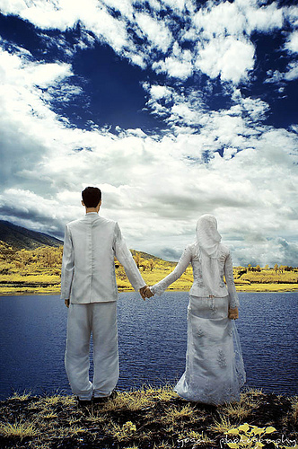
Warm Up Activity
Get into pairs
You have 3 minutes to EACH
answer these questions:
What do relationships add to our lives?
How do you create and maintain positive relationships in your life?
Switch partners!
Notes:
This slide can be used for the Speed Dating Activity, which is a cooperative learning activity. If use of the term “speed dating” intimidates your students, you might want to reassure them that they are actually not dating other students or interviewing them as possible dates. This is simply a way to get students to talk to one another. Depending on the time available and the class size, you can have students talk to many or a few other students.
(Click) 1) Get into pairs
You can set this up like a speed dating situation, but with students standing around the room. Some students will stay where they are, while half of the students will switch partners after each interaction.
(Click) 2) You have 3 minutes to EACH answer these questions:
Emphasize that there is not a lot of time. You will want to let them know that they will be switching partners after 3 minutes to do it again.
(Click) What do relationships add to our lives?
How do you create and maintain positive relationships in your life?
Explanation: This will get students thinking about interpersonal relationships, especially the positive aspects of them.
People in happier marriages also have more positive emotions expressed in parent-child dyads (Barry & Kochanska, 2010).
(Click) Switch partners.
Reference:
Barry, R. A., & Kochanska, G. (2010). A longitudinal investigation of the affective environment in families with young children: From infancy to early school age. Emotion, 10(2), 237-249. doi:10.1037/a0018485

Slide 6
Overview
Introduction
Positive Relationship Deposits
The Magic Formula
Opportunities for Positive Deposits
Conclusion
Notes:
The purpose of this slide is to provide students with an overview of the material that will be covered during the lecture.

Slide 7

Positive Relationship Deposits
Metaphor of a bank account
Accumulated positive deposits
Help a relationship when in conflict
Negative withdrawals
Notes:
This slide introduces the topic of positive relationship deposits.
(Click) Metaphor of a bank account
Explanation: Using a metaphor of a bank account, the module suggests we should make regular positive deposits, which will help buffer the negative parts of relationships.
(Click) Accumulated positive deposits
(Click) Help a relationship when in conflict
For example, having positive experiences with your romantic partner can buffer the negative effects of conflict.
(Click) Negative withdrawals
The negativity bias says that we pay more attention to negative than to the positive, and that’s also true to interactions in our relationships. A negative withdrawal (interactions) in a relationship have the potential to deplete our resources. People in unhappy marriages tend to have more negative interactions than positive interactions (see Fitness & Williams, 2013 for a review).
Reference:
Fitness, J., & Williams, V. (2013). The features and functions of positive emotions in close relationships. In M. Hojjat & D. Cramer (Eds.), Positive Psychology of Love (pp. 44-56). Oxford University Press, New York, NY.

Slide 8
Overview
Introduction
Positive Relationship Deposits
The Magic Formula
Opportunities for Positive Deposits
Conclusion
Notes:
The purpose of this slide is to provide students with an overview of the material that will be covered during the lecture.

Slide 9
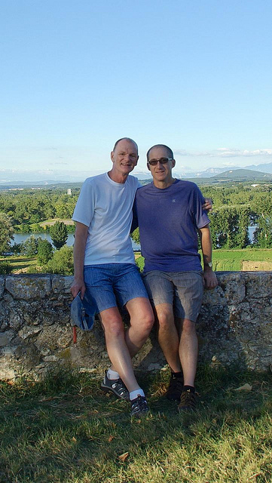
The Magic Formula
What is the ideal ratio of positive to negative interactions in a relationship?
5 to 1
Happiest relationships:
8 to 1
Notes:
This slide introduces the concept of a ‘magic formula’ for positive relationships.
(Click) Discussion Question: What is the ideal ratio of positive to negative interactions in a relationship?
(Click) 5 to 1
Explanation: Some research has found that happier couples have, for every negative interaction, 5 positive interactions. So, the “magic formula” may be 5:1.
(Click) Happiest relationships:
(Click) 8 to 1
Explanation: People in unhappy marriages tend to have more negative interactions than positive interactions, and people in the the happiest marriages have an 8:1 ratio (see Fitness & Williams, 2013 for a review). Please note that the 8:1 ratio is not in the module, and this has been found in the happiest marriages.
Reference:
Fitness, J., & Williams, V. (2013). The features and functions of positive emotions in close relationships. In M. Hojjat & D. Cramer (Eds.), Positive Psychology of Love (pp. 44-56). Oxford University Press, New York, NY.

Slide 10
Overview
Introduction
Positive Relationship Deposits
The Magic Formula
Opportunities for Positive Deposits
  Capitalization and Active-Constructive Responding
  Gratitude
  Forgiveness
  Spending Time in Meaningful Ways
Conclusion
Notes:
The purpose of this slide is to provide students with an overview of the material that will be covered during the lecture.

Slide 11
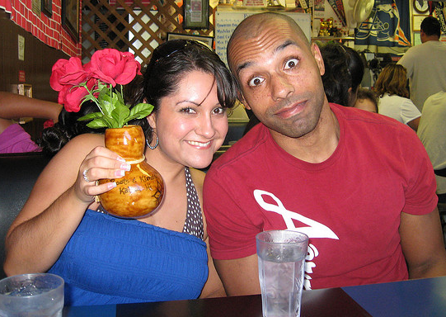
Opportunities for
Positive Deposits
Capitalization
Active-Constructive Responding
Notes:
This slide begins the discussion of how to increase our positive relationship deposits.
Negative events have more impact on us than positive events (known as the negativity bias), and negative events will happen occasionally. How can we increase our positive interactions? The module describes how to create more positive relationship deposits with capitalization and active-constructive responding, gratitude, forgiveness, and spending time together in meaningful ways. This slide emphasizes capitalization and active-constructive responding.
(Click) Capitalization:
Explanation: Capitalization is when you seek out someone to share good news with them. Sharing good news with someone has been associated with greater well-being and positive emotions, above and beyond the effect of the good news itself (Gable, Reis, Impett, & Asher, 2004).
(Click) Active-Constructive Responding:
Explanation: Active-constructive responding is when a person responds positively to good news being relayed to them, being authentic, enthusiastic, and supportive. Responding in such a way increases relationship satisfaction and intimacy (Gable et al., 2004).
Reference:
Gable, S. L., Reis, H. T., Impett, E. A., & Asher, E. R. (2004). What do you do when things go right? the intrapersonal and interpersonal benefits of sharing positive events. Journal of Personality and Social Psychology, 87(2), 228-245. doi:10.1037/0022-3514.87.2.228

Slide 12
Active & Constructive
Authentic, Enthusiastic,
Supportive
Passive & Constructive
Understated Support
Active & Destructive
Pointing out the Negative
Passive & Destructive
Ignoring the Event
Notes:
This slide replicates Figure 1 in the module. Figure 1 in the module illustrates 4 different types of responding.
(Click) Active & Constructive – Authentic, Enthusiastic, Supportive
The best and most positive response is active and constructive responding, which is enthusiastic and supportive.
(Click) Passive & Constructive – Understated support
Passive and constructive is understated support. While it is still constructive, it is not perceived as positively as active and constructive responding.
(Click) Active & Destructive – Pointing out the Negative
Active and destructive responding is pointing out the negative. Not recommended.
(Click) Passive & Destructive – Ignoring the Event
Passive and destructive responding is ignoring the event. Not recommended.

Slide 13
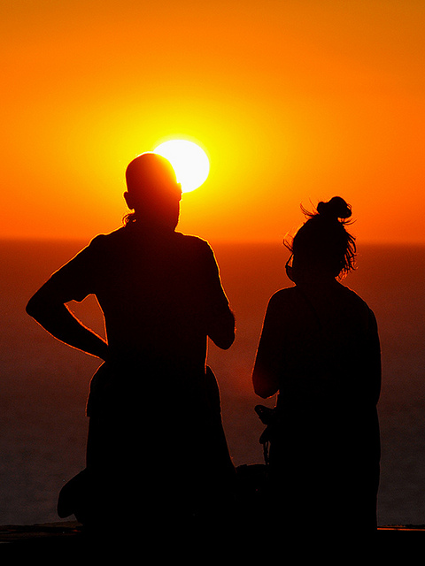
Capitalization and Active-Constructive Responding Activity
Activity:
Share 3 good things that have
happened in the last 24 hours
Use active-constructive responding
Take turns
How did it feel?
To share a positive event?
To use active-constructive responding?
To receive it?
Notes:
This slide outlines an activity designed to further explore capitalization and active-constructive responding.
(Click) Activity:
Explanation: This classroom activity gives students a chance to practice capitalization and active-constructive responding.
(Click) Share three good things that have happened in the last 24 hours:
Explanation: Individuals were happier on days when they shared the most positive parts of their day with their romantic partners (Hicks & Diamond, 2008). This activity is based on the Three Good Things activity (Seligman et al., 2005).
(Click) Respond with active-constructive responding
This instructs the students to use active-constructive responding, which is the most positive response to good news.
(Click) Take turns so that each of you share and respond
Explanation: Each person should share three things, which gives each person (if they are in dyads) three opportunities to respond.
(Click) How did it feel to share a positive event?
(Click) How did it feel to use active-constructive responding?
(Click) To receive it?
References:
Hicks, A. M., & Diamond, L. M. (2008). How was your day? couples' affect when telling and hearing daily events. Personal Relationships, 15(2), 205-228. doi:10.1111/j.1475-6811.2008.00194.x
Seligman, M. E. P., Steen, T. A., Park, N., & Peterson, C. (2005). Positive psychology progress: Empirical validation of interventions. American Psychologist, 60(5), 410-421. doi:10.1037/0003-066X.60.5.410

Slide 14
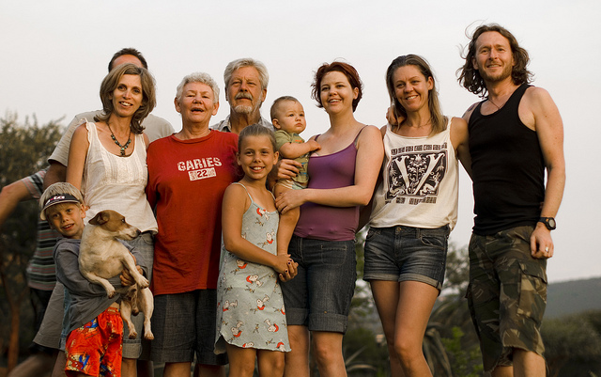
Opportunities for
Positive Deposits
Application:
Share positive things about your day with your family/friend/romantic partner
Use active-constructive responding
How do you respond to their positive event?
Notes:
This slide outlines a practical application of capitalization and active-constructive responding.
(Click) Application:
Explanation: This gives students a practical tip for their relationships.
(Click) Share the most positive things about your day with your family/friend/romantic partner each evening.
Explanation: Individuals were happier on days when they shared the most positive parts of their day with their romantic partners (Hicks & Diamond, 2008). The slide also mentions family and friends, to expand this to different relationship as well as not exclude students who are not in romantic relationships.
(Click) Use active-constructive responding:
Explanation: This is the best type of response to positive news, and it’s most likely to enhance a relationship.
(Click) How do you respond to their positive event?
This question reminds the students about active-constructive responding. If a student answers, “active constructive responding,” then you can follow up with a “How would you do that?” question to probe their knowledge of the topic.
Reference:
Hicks, A. M., & Diamond, L. M. (2008). How was your day? couples' affect when telling and hearing daily events. Personal Relationships, 15(2), 205-228. doi:10.1111/j.1475-6811.2008.00194.x

Slide 15

CAT: One-Minute Paper
What was the most important thing you learned during this class?
What important question remains unanswered?
Notes:
Classroom Assessment Technique (CAT): One-Minute Paper
If you are presenting the information on one class day, you might end the material about here. End your class time with a one-minute paper.
The Minute Paper tests whether students are gaining knowledge, or not. The instructor ends class by asking students to write a brief response to the following questions: “What was the most important thing you learned during this class?” and “What important question remains unanswered?”
Have students briefly answer these questions in writing and turn them in. After class, assess students’ responses. At the beginning of the next class, go over any misunderstandings or relevant questions.
If you do not conclude with this Classroom Assessment Technique (CAT), it would helpful to use another CAT. It could be in the form of a:
Muddy point
One-minute paper
Background knowledge
What’s the Principle?
Defining features Matrix:
For more information on CATs click here: http://cft.vanderbilt.edu/guides-sub-pages/cats/

Slide 16
Overview
Introduction
Positive Relationship Deposits
The Magic Formula
Opportunities for Positive Deposits
  Capitalization and Active-Constructive Responding
  Gratitude
  Forgiveness
  Spending Time in Meaningful Ways
Conclusion
Notes:
The purpose of this slide is to provide students with an overview of the material that will be covered during the lecture.

Slide 17

One-Minute
Paper Responses
Revisiting your answers to the One-Minute Paper
What was the most important thing you learned during this class?
What important question remains unanswered?
Notes:
This slide provides an opportunity to discuss students’ responses in the one-minute paper activity which was conducted in the previous class session. It’s your chance to clear up any misunderstandings or misconceptions, as well as orient students to the material again.
(Click): Revisiting your answers to One-Minute Paper
(Click): What was the most important thing your learned during class?
(Click): What important question remains unanswered?

Slide 18
Satisfaction w/Life Activity: Part 1
Use a 7-point scale to agree or disagree with these items. 7 = strongly agree and 1 = strongly disagree
1 2 3 4 5 6 7
In most ways, my life is close to my ideal
The conditions of my life are excellent
I am completely satisfied with my life
So far I have gotten the most important things I want in life
If I could live my life over, I would change nothing
Notes:
This slide has students take the Satisfaction with Life Scale, which can also be found at https://www.authentichappiness.sas.upenn.edu/
(Click) Use a 7-point scale to agree or disagree with these items. 7 = strongly agree and 1 = strongly disagree
1 2 3 4 5 6 7
(Click) 1) In most ways, my life is close to my ideal.
2) The conditions of my life are excellent.
3) I am completely satisfied with my life.
4) So far I have gotten the most important things I want in life.
5) If I could live my life over, I would change nothing.
Having students take the Satisfaction with Life Scale before engaging in the Gratitude Letter Activity as a pre-test will help you discuss, after the activity, how the activities may impact satisfaction with life.
Reference:
Diener, E. D., Emmons, R. A., Larsen, R. J., & Griffin, S. (1985). The satisfaction with life scale. Journal of Personality Assessment, 49(1), 71-75.

Slide 19
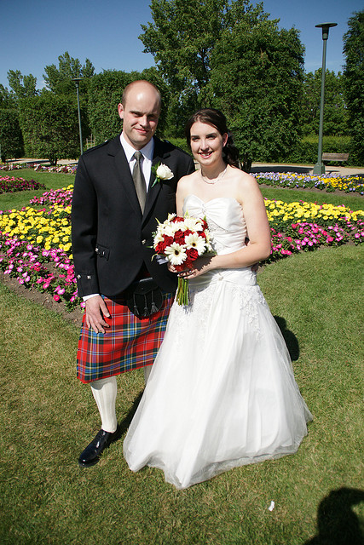
Opportunities for
Positive Deposits
Gratitude
Notes:
This slide continues the discussion of how to increase our positive relationship deposits. This slide emphasizes gratitude.
(Click) Gratitude
Explanation: Expressing gratitude to your relationship partner is a good way to build up positive relationship deposits. ‘Others’ could be friends, family, romantic partners, co-workers, or anyone you want to have a positive relationship with.

Slide 20

Gratitude Letter Activity
Take out a piece of paper
Think of a person in your life
Write a letter to that person, expressing your gratitude to them
Notes:
This slide helps guide the Gratitude Letter Activity.
(Click) 1) Take out a piece of paper.
If you want to make it seem more like a letter (and have the monetary resources), you can provide cards/paper and an envelope to each student. Providing an envelope will make it more likely that they will actually mail the letter.
(Click) 2) Think of a person in your life
3) Write a letter to that person, expressing your gratitude to them.
This letter can be to anyone in their lives, living or dead. They can be in touch with the person or not. The exercise is simply about writing the letter. If you show the video on the next slide, you can engage in a discussion at that point about whether they want to mail the letter (or call the person and read it to them, as seen in the video on Slide 22).

Slide 21
Satisfaction w/Life Activity: Part 2
Use a 7-point scale to agree or disagree with these items. 7 = strongly agree and 1 = strongly disagree
1 2 3 4 5 6 7
In most ways, my life is close to my ideal
The conditions of my life are excellent
I am completely satisfied with my life
So far I have gotten the most important things I want in life
If I could live my life over, I would change nothing
Are your ratings different now? Why or why not?
Notes:
This slide has students take the Satisfaction with Life Scale, which can also be found at https://www.authentichappiness.sas.upenn.edu/
(Click) Use a 7-point scale to agree or disagree with these items. 7 = strongly agree and 1 = strongly disagree
2 3 4 5 6 7
(Click) 1) In most ways, my life is close to my ideal.
2) The conditions of my life are excellent.
3) I am completely satisfied with my life.
4)So far I have gotten the most important things I want in life.
5) If I could live my life over, I would change nothing.
(Click) Are your ratings different now? Why or why not?
This is the post-test. After student take the Satisfaction with Life Scale this time, explain the scale to them, and ask them whether their scores are different this time. Did the activities make a difference?
Reference:
Diener, E. D., Emmons, R. A., Larsen, R. J., & Griffin, S. (1985). The satisfaction with life scale. Journal of Personality Assessment, 49(1), 71-75.

Slide 22
Opportunities for
Positive Deposits
Gratitude
An Experiment in Gratitude
Application:
Regularly express gratitude to others
Notes:
This slide continues the discussion of how gratitude increases positive relationship deposits.
(Click) An Experiment in Gratitude
Optional video: This is a 7-minute video about gratitude, and it includes people writing gratitude letters. After they write the letters, they are told to call the person they wrote and read them the letter. At the end of the video, data is presented, showing how writing the letter can increase positive emotions, especially if they read the letter to the person.
https://www.youtube.com/watch?v=oHv6vTKD6lg
After the video, you can also discuss whether they think they will mail their own gratitude letter.
(Click) Application:
(Click) Regularly express gratitude to others
Explanation: This information is intended to help students create more positive relationship deposits in their own relationships.

Slide 23
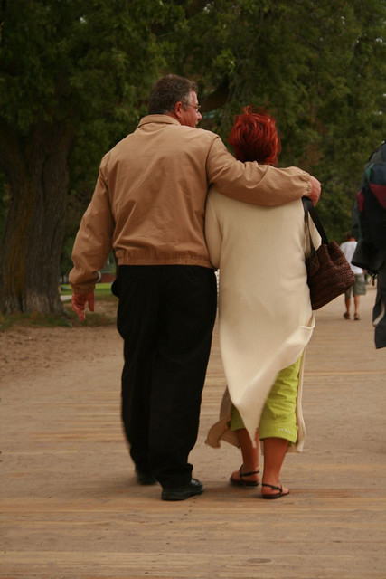
Opportunities for
Positive Deposits
Forgiveness
The Science of Happiness – Forgive and Forget
Application:
Write a forgiveness letter
Notes:
This slide continues the discussion of how to increase our positive relationship deposits. This slide emphasizes forgiveness
(Click) Forgiveness
Explanation: Forgiving your partner is a way to increase commitment and relationship satisfaction.
(Click) The Science of Happiness – Forgive and Forget
This is a hyperlink to a YouTube video, at https://www.youtube.com/watch?v=8o9_TlZyB_Y
It is a 7-minute, 18-second video about forgiveness and happiness.
(Click) Application: Write a forgiveness letter
To use this in their own lives, students could write a letter of forgiveness to someone they know.
Some more information on forgiveness:
http://www.pbs.org/thisemotionallife/topic/forgiveness/understanding-forgiveness
Another video about forgiveness:
http://www.thedenverchannel.com/news/local-news/windsor-woman-will-ask-parole-board-to-free-drunk-driver-who-killed-her-husband-and-daughter

Slide 24
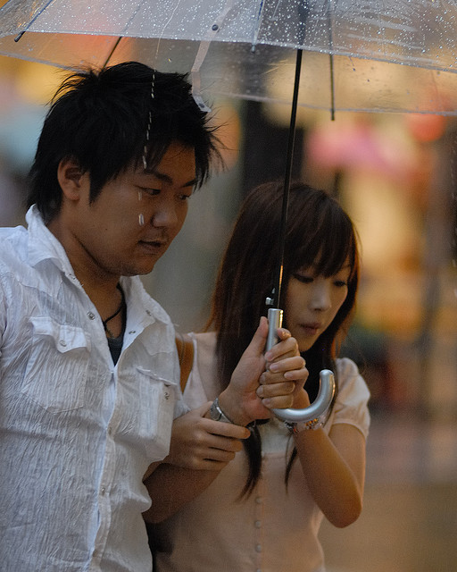
Opportunities for
Positive Deposits
Spending Time in Meaningful Ways
Application:
Do interesting, novel things with others
Notes:
This slide continues the discussion of how to increase our positive relationship deposits. This slide emphasizes spending time in meaningful ways.
(Click) Spending Time in Meaningful Ways
Explanation: Spending time with your partner can be a way to build up positive relationships deposits. Further, doing novel, interesting activities with each other is more helpful for your relationship than doing routine activities.
(Click) Application:
(Click) Do interesting, novel things with others
‘Others’ could be friends, family, romantic partners, co-workers, or anyone you want to have a positive relationship with.
Optional Discussion Question: What are some activities you could do with a friend or partner that would be interesting, fun, and unique?

Slide 25
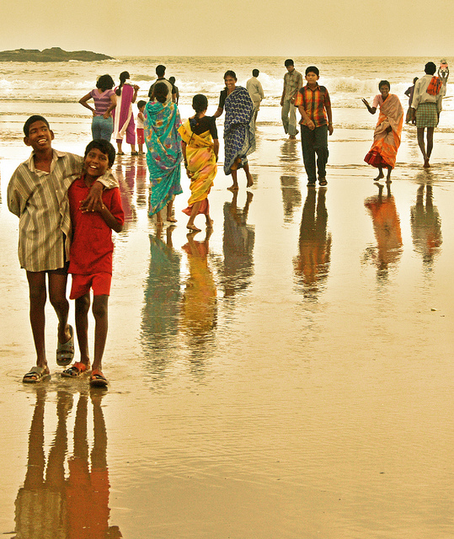
Wrap Up: Application Plan Activity
How are you going to use this
information to help improve
your relationships?
Which relationship will you focus on?
What, specifically, will you do?
Why do you think this is important?
Notes:
This slide outlines questions that guide students to create a concrete plan to implement the information they have learned in this module. It will also serve as a review of the information.
(Click) How are you going to use the information you learned today to help improve your relationships?
This question provides an overview of what this plan activity will look like.
(Click) 1) Which relationship will you focus on?
You might want to emphasize that plans are helpful when they are specific and concrete.
(Click) 2) What, specifically, will you do?
Again, plans are helpful when they are specific. It may be helpful to discuss action triggers, which may prompt people to act. So, a specific plan with an action trigger might be, “When I pack my daughter’s lunch, I will put in a positive note.” Packing the lunch is the trigger, with the putting in a note being the action.
(Click) 3) Why do you think this is important?
This will help students think of motivations to engage in these actions, as well as help them connect the plan back to the material that has been covered.

Slide 26

Conclusion
Notes:
This is a good time to refer back to the Warm Up Activity. If you can remember, note students’ responses to the ‘What do relationships add to our lives?” question, and emphasize the importance of interpersonal relationships in our lives, as well as the importance of positive interactions within our relationships.

Slide 27
CAT: Chain Letter Activity
Get into groups.
Answer the question on the envelope you receive. Put your group’s answer into the envelope. Don’t put your names on your answers.
When you get the next envelope, talk about how you would answer the question. Then, read the previous group’s answer. Discuss their answer. Add any additional information you think is necessary.
Notes:
Classroom Assessment Technique (CAT): Chain Letter Activity
This slide presents one version of the Chain Letter Activity, a Classroom Assessment Technique (CAT). There are various ways to conduct this activity, and this version includes getting students into groups. This activity is also explained in the IM – Instructional Framework section.
1) Get into groups.
Based on the number of students in the class and the number of envelopes you have, get students into groups. Groups of 2-4 would be ideal.
2) Answer the question on the envelope you receive. Put your group’s answer into the envelope. Don’t put your names on your answers. Pass the envelope with your answer to the next group.
3) When you get the next envelope, talk about how you would answer the question. Then, read the previous group’s answer. Discuss their answer. Add any additional information you think is necessary.
Depending on time, you can go through their answers in class or after class. If you go through the answers after class, be sure to report back at the beginning of the next class.
This activity requires that you provide large envelopes for students with questions on them. If you have a large class, you can have multiple envelopes with the same questions on them to facilitate smaller student groups. Questions could include:
Please list two concrete, specific things you could do to increase positive relationship deposits in a romantic relationship. Each group should add two more suggestions.
Please list two concrete, specific things you could do to increase positive relationship deposits in your relationship with a parent. Each group should add two more suggestions.
What is active-constructive responding? Clearly explain the concept. Also, each group should give one concrete example of how to display active-constructive responding.
What is capitalization? Clearly explain the concept and give an example. Each group should generate a different example.
What are accumulated positive deposits? Clearly explain the concept.
If you do not conclude with this Classroom Assessment Technique (CAT), it would helpful to use another CAT. It could be in the form of a:
Muddy point
One-minute paper
Background knowledge
What’s the Principle?
Defining features Matrix:
For more information on CATs click here: http://cft.vanderbilt.edu/guides-sub-pages/cats/

Slide 28
Photo Attribution
Slide 1 | Photo Credit: butch/femme at pride Gretchen Ludwig https://www.flickr.com/photos/18097037@N00/175902260/ https://creativecommons.org/licenses/by-nc/2.0/
Slide 4 | Photo Credit: Talking things over Ed Yourdon https://www.flickr.com/photos/yourdon/9318455137 https://creativecommons.org/licenses/by-nc-sa/2.0/
Slide 5 | Photo Credit: if tomorrow never comes Prayoga D. Widyanto https://www.flickr.com/photos/8335061@N08/4283781210/ https://creativecommons.org/licenses/by/2.0/
Slide 7 | Photo Credit: Bank 401(K) 2012 https://www.flickr.com/photos/68751915@N05/6629034769/ https://creativecommons.org/licenses/by-sa/2.0/
Slide 9 | Photo Credit: Viviers_couple3 Ed and Eddie https://www.flickr.com/photos/96054322@N00/10352581156/ https://creativecommons.org/licenses/by-sa/2.0/
Slide 11 | Photo Credit: Happy Couple Hawaiian Vacation Ian D. Keating https://www.flickr.com/photos/32008328@N08/4095302641/ https://creativecommons.org/licenses/by/2.0/
Slide 13 | Photo Credit: Molyvos - Couple in Sunset Drriss & Marrionn https://www.flickr.com/photos/61943224@N04/8188170454/ https://creativecommons.org/licenses/by-nc-sa/2.0/
Slide 14 | Photo Credit: South_Africa_Dec_10_434 Jason Jones https://www.flickr.com/photos/13408725@N03/5334784682/ https://creativecommons.org/licenses/by-nc-sa/2.0/
Slides 15 & 27 | Photo Credit: Illustrated silhouette of a black cat nehtaeh79 http://www.freestockphotos.biz/stockphoto/16624 http://creativecommons.org/publicdomain/zero/1.0/
Slide 17 | Photo Credit: Questions1 Grisel D´An https://www.flickr.com/photos/128454566@N06/15893429463 https://creativecommons.org/licenses/by-nc/2.0/
Slides 19 & 22 | Photo Credit: DSC01045 Cherrysweetdeal https://www.flickr.com/photos/41247213@N00/3788844056/ https://creativecommons.org/licenses/by/2.0/
Notes:
Photo Attribution Slide

Slide 29
Photo Attribution
Slide 20 | Photo Credit: 365.8 (Distracted by Penmanship) Kim Piper Werker https://www.flickr.com/photos/kpwerker/2635694952 https://creativecommons.org/licenses/by-sa/2.0/
Slide 23 | Photo Credit: On a Stroll Benjamin Jakabek https://www.flickr.com/photos/8454450@N08/2806938994/ https://creativecommons.org/licenses/by-nc-nd/2.0/
Slide 24 | Photo Credit: August 18 Kiks Balayon https://www.flickr.com/photos/8434252@N06/2771521182/ https://creativecommons.org/licenses/by-nc-nd/2.0/
Slide 25 | Photo Credit: Gokarna David https://www.flickr.com/photos/11144074@N00/5720010136/ https://creativecommons.org/licenses/by-nc-nd/2.0/
Slide 26 | Photo Credit: Spitalfields part VI Ville Miettinen https://www.flickr.com/photos/62223880@N00/284084730/ https://creativecommons.org/licenses/by-nc/2.0/
Notes:
Photo Attribution Slide

